Slide 1
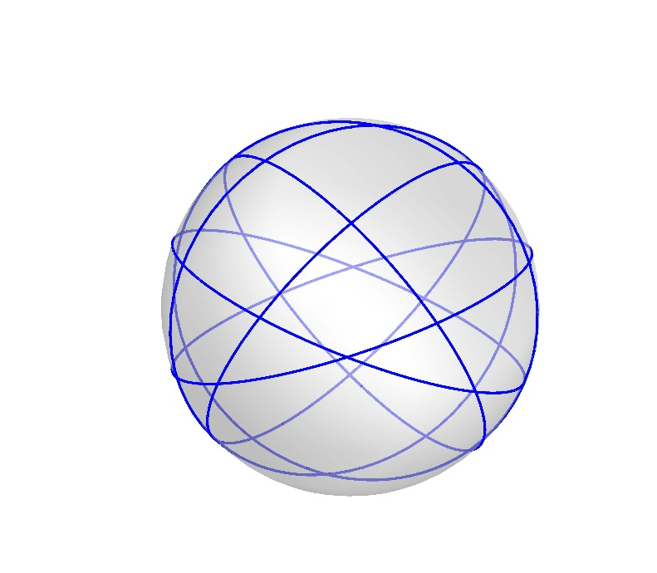
Great Circles Problem
Kha Man
03/07/2015

Slide 2
Outline
This note mentions some observations obtained from the data that I currently have and some conjectures.
The goal is still to get the chromatic number of the graph as 3.
Our problem is actually to color a planar 4-regular graph which is NP Complete ^{[1]}.

Slide 3
Conjecture 1.
Remove a circle containing all the vertices and edges incident into that vertices will separate the graph into 2 graphs with same colors, number of vertices and shape.

Slide 4
Conjecture 1 - Observation
Starting with one non-isomorphic graph of 6 great circles as the graph below, I tried to remove one circles. The reason is to split the problem into sub problems we’ve already known or to enable a way to prove by induction hypothesis.
Black numbers: Vertices
Red numbers: The edges on the circle

Slide 5
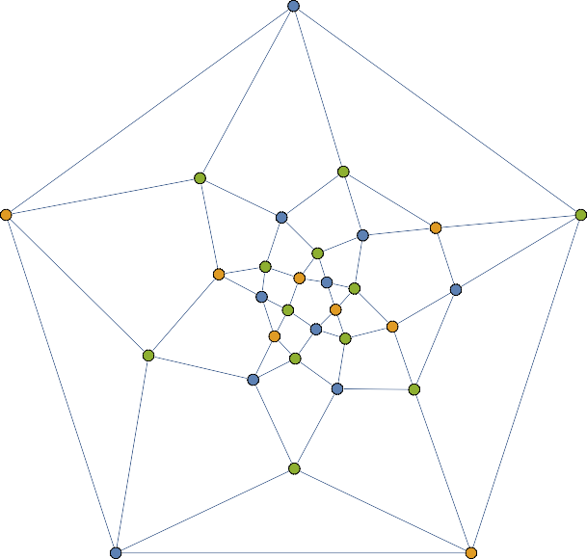
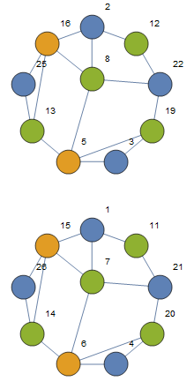
Conjecture 1 – Observation - Remove circle 1
1
7
11
15
21
23
9
17
20
27
29
6
25 ₁₃
4
3
10 16
5
24
2
8
14
12
18
22
19
30
26
28

Slide 6
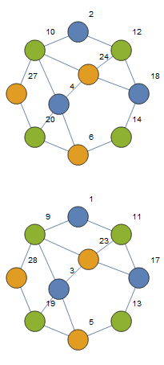
Conjecture 1 – Observation - Remove circle 2
1
7
11
15
21
23
9
17
20
27
29
6
25 ₁₃
4
3
10 16
5
24
2
8
14
12
18
22
19
30
26
28

Slide 7
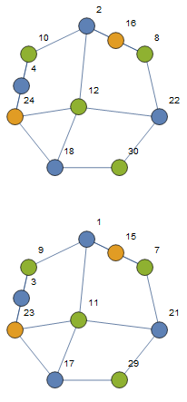
Conjecture 1 – Observation - Remove circle 3
1
7
11
15
21
23
9
17
20
27
29
6
25 ₁₃
4
3
10 16
5
24
2
8
14
12
18
22
19
30
26
28

Slide 8
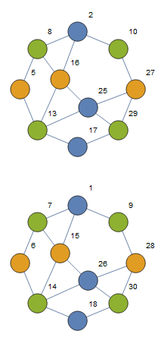
Conjecture 1 – Observation - Remove circle 4
1
7
11
15
21
23
9
17
20
27
29
6
25 ₁₃
4
3
10 16
5
24
2
8
14
12
18
22
19
30
26
28

Slide 9
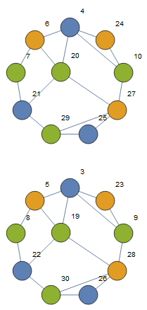
Conjecture 1 – Observation - Remove circle 5
1
7
11
15
21
23
9
17
20
27
29
6
25 ₁₃
4
3
10 16
5
24
2
8
14
12
18
22
19
30
26
28

Slide 10
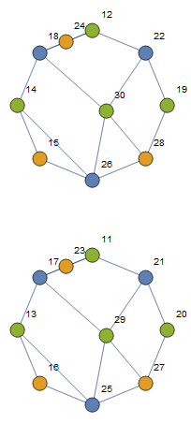
Conjecture 1 – Observation - Remove circle 6
1
7
11
15
21
23
9
17
20
27
29
6
25 ₁₃
4
3
10 16
5
24
2
8
14
12
18
22
19
30
26
28

Slide 11
Conjecture 2.
Intersections made by a pair of great circles can have same color.
This one is probably easily proved since we’ve already known the center is symmetric point, therefore by removing a circle, it will separate the graph into 2 sub-graphs equally. Hence, 2 intersections made by a pair of great circles can have same color because they are not in the same sub-graph. What we need more than this conjecture is it still remains 3 colors for the entire graph
You can check this conjecture on the graphs in the conjecture 1. Check the previous note to find the a point and its duplication (or other intersect made by same pair of circles)

Slide 12
Conjecture 3.
The graph will have a bounded cycle and a core which are formed by the greatest number of line segments.
The bounded cycle and the core contain vertices made by different pairs of great circles. In other words, there is no 2 or more vertices can be in a same circle in the bounded cycle and the core.

Slide 13
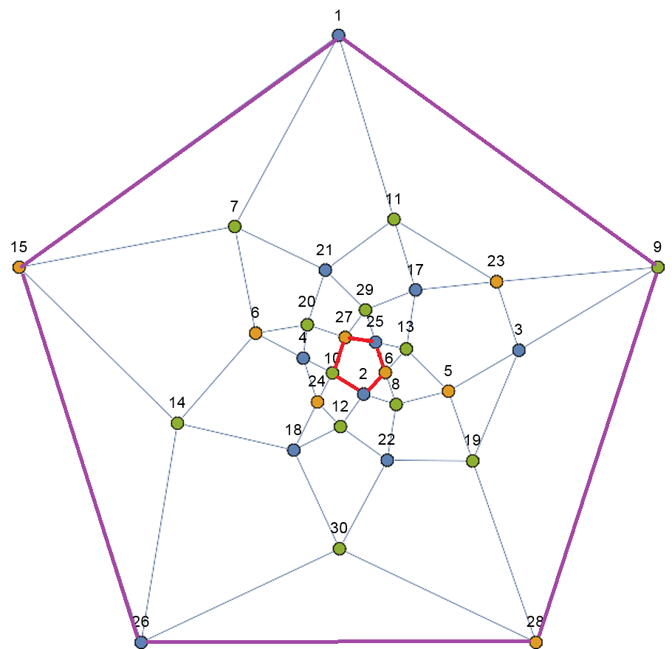
Conjecture 3 - Observation
Red lines are segments of the core polygon
Purpil lines are segments of the bounded polygon

Slide 14
References
David P. Dailey, Uniqueness of colorability and colorability of planar 4-regular graphs are NP-complete, Discrete Math. 30 No.3 289-293 (1980)

